Slide 1
Automated Examination System
Project Overview and Development
By:
AbdEl-Rhman Ashraf Mohamad
Mohanad Osama Ashraf
Fatma Amer Elsayed
Hossam AbdEl-Moaty
Ahmed Ebrahim AbdEl-Hafeez

Slide 2
Agenda
Introduction
Project Overview
Development Steps:
Requirements Analysis
Preparation
Sharing
Demonstration
Conclusion
Q&A

Slide 3
Introduction
Purpose
Overview of the project
Key achievements
Importance of Automated Exams
Benefits over traditional methods
Relevance in today's educational landscape

Slide 4
Project Overview
Objective
Construct an automated system for conducting exams.
Develop a robust SQL database to support the system.
Key Components
Database Design
Stored Procedures
ETL Pipeline
Desktop Application
Reporting and Analytics

Slide 5
Development Steps: Requirements Analysis
Analyzing System Requirements
Identify Stakeholders
Determine Functional Requirements
Exam Generation
Answer Submission
Grading and Reporting

Slide 6
Development Steps: Requirements Analysis
Database Entities and Relationships
Entities
Applicant, Instructor, Course, Exam, Questions, Student Answers, etc.
Relationships
One-to-Many (e.g., Instructor to Courses)
Many-to-Many (e.g., Instructors and Courses via Instructor_Course)

Slide 7
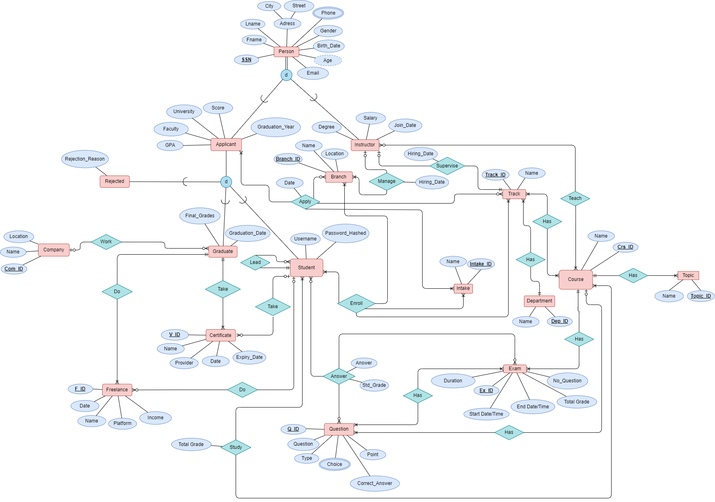
Development Steps: Preparation
ERD (Entity-Relationship Diagram)

Slide 8
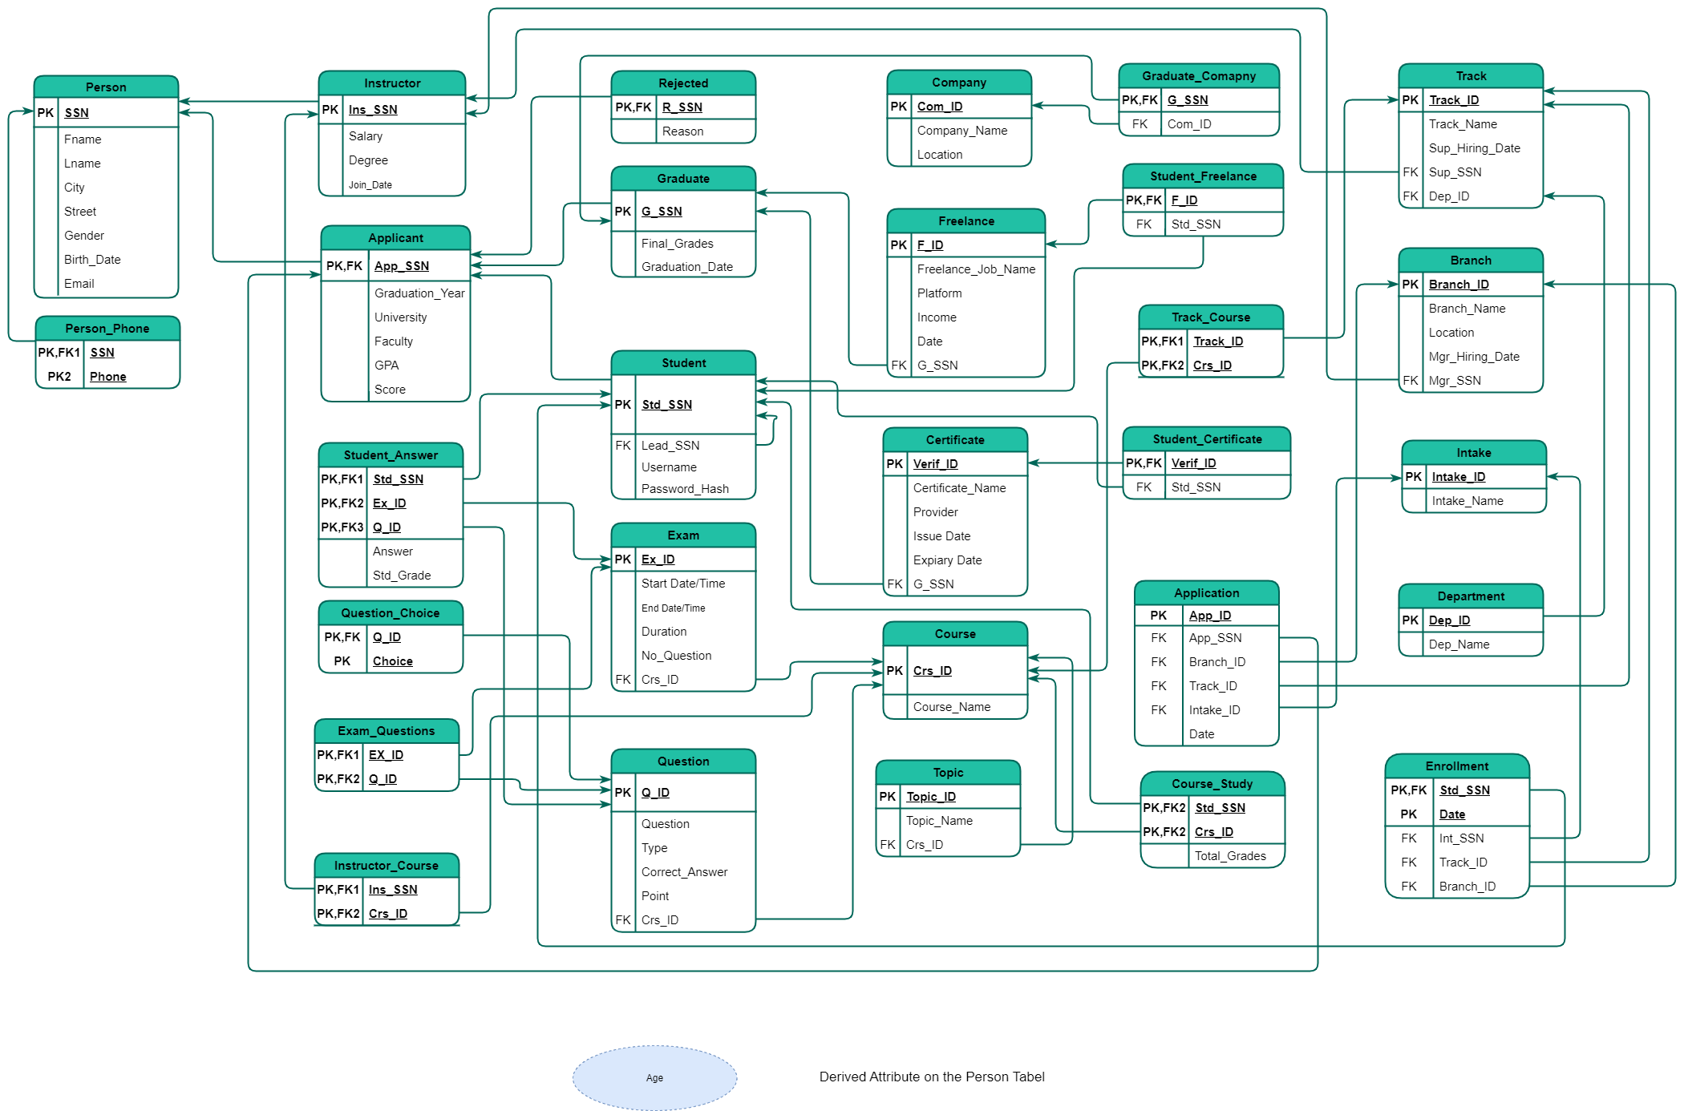
Development Steps: Preparation
Implementing Mapping Roles and Building the Database Schema

Slide 9
Development Steps: Preparation
Database Development
Creating Tables
Highlight key tables with attributes and data types.
Defining Relationships
Explain foreign key constraints and relationships between tables.

Slide 10
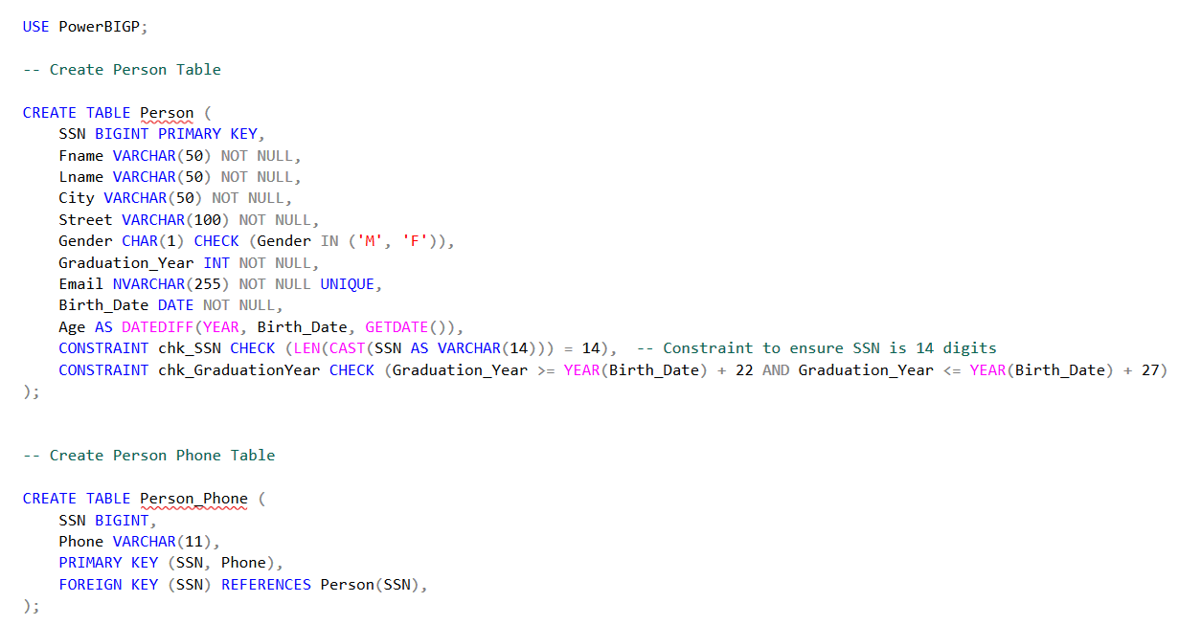
Development Steps: Creating Tables

Slide 11



Development Steps: Generating Row Data
Generating Row Data
Data Generation Tools

Slide 12
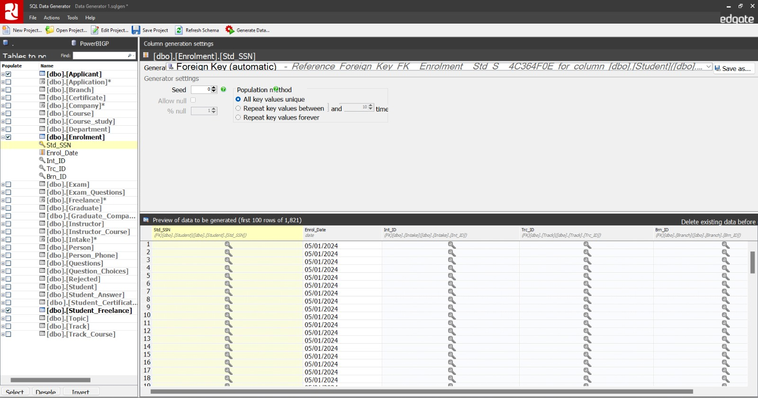
Development Steps: Generating Row Data
Sample Data Example

Slide 13
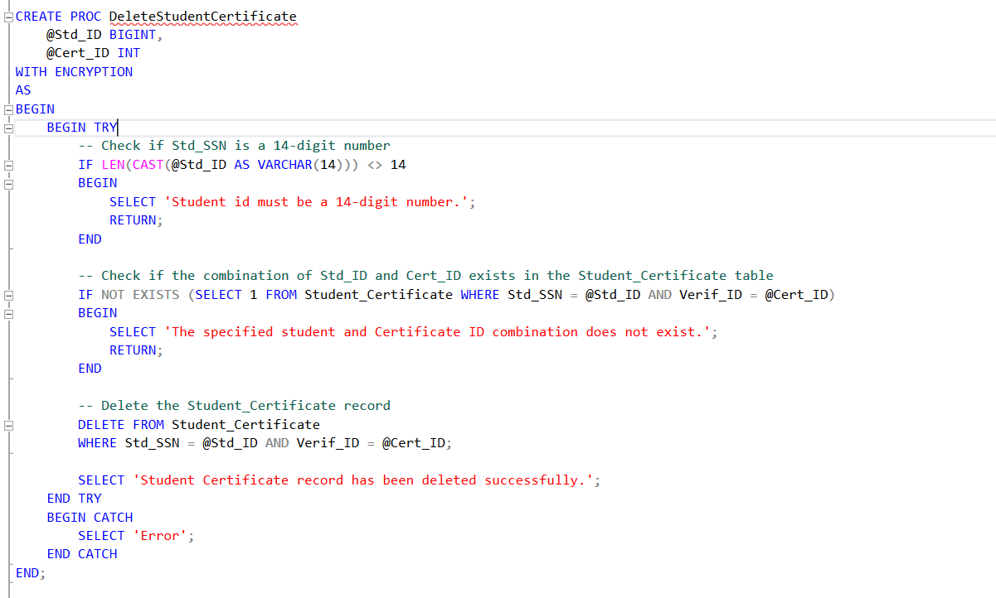
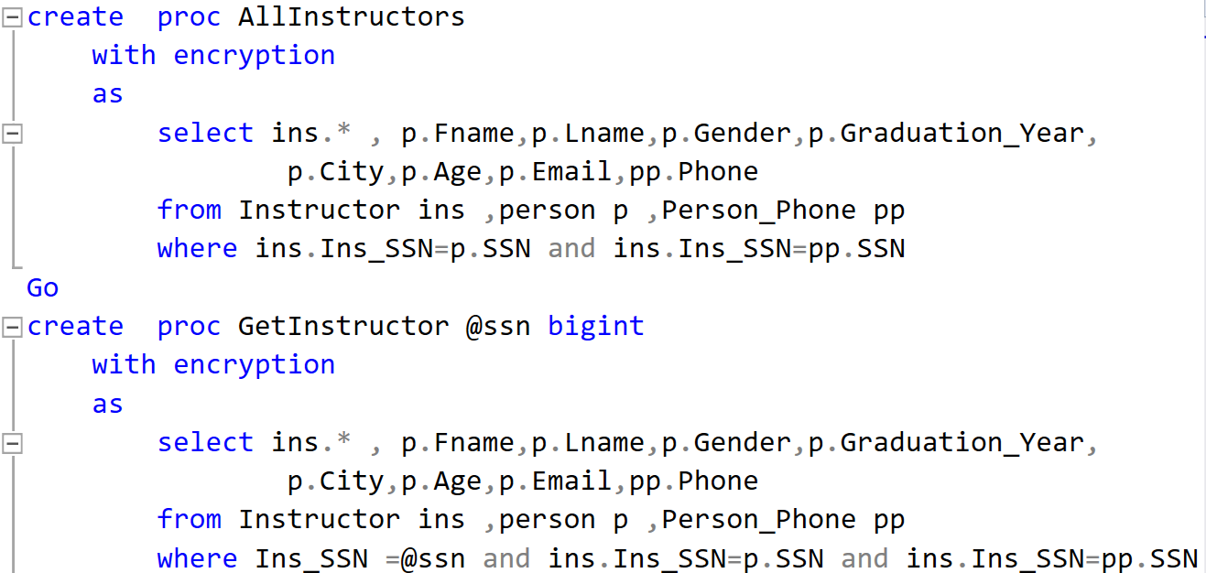
Development Steps: Stored Procedures
Creating Stored Procedures (SP)
Purpose of Stored Procedures
Manage CRUD operations.
Enhance security and performance.

Slide 14
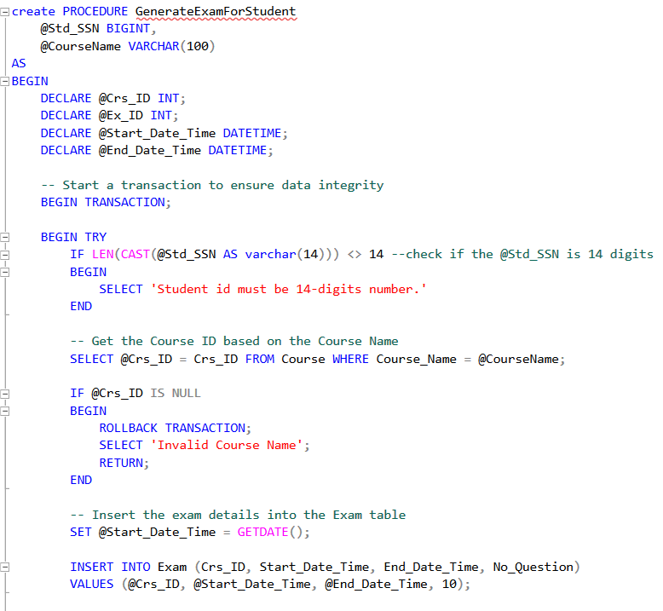
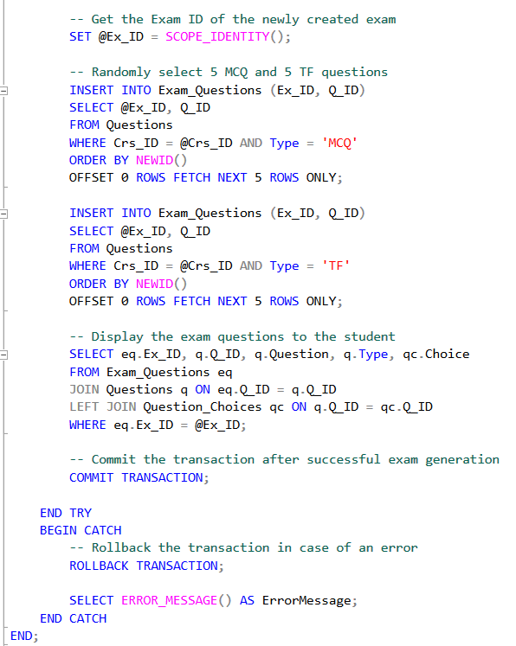
Development Steps: Stored Procedures
Creating Stored Procedure For Exam Generation

Slide 15
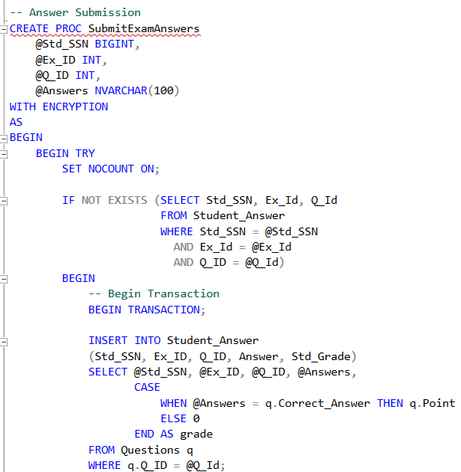
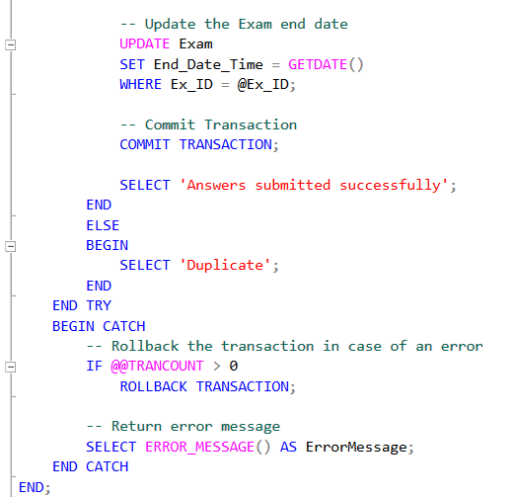
Development Steps: Stored Procedures
Creating Stored Procedure For Answer Submission and Correction

Slide 16
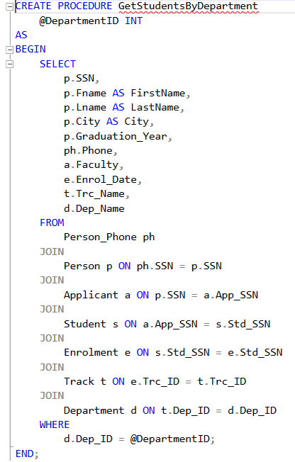
Development Steps: Stored Procedures
Creating Stored Procedure For SSRS Reports
Report No.1:
Report that returns the students information according to Department No parameter.

Slide 17
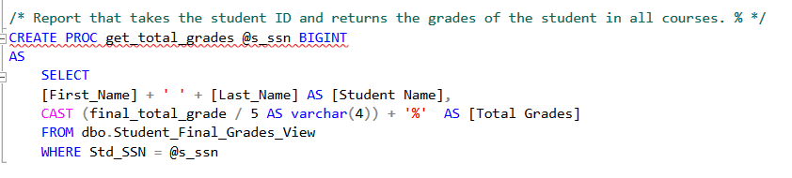
Development Steps: Stored Procedures
Creating Stored Procedure For SSRS Reports
Report No.2:
Report that takes the student ID and returns the grades of the student in all courses. %.

Slide 18
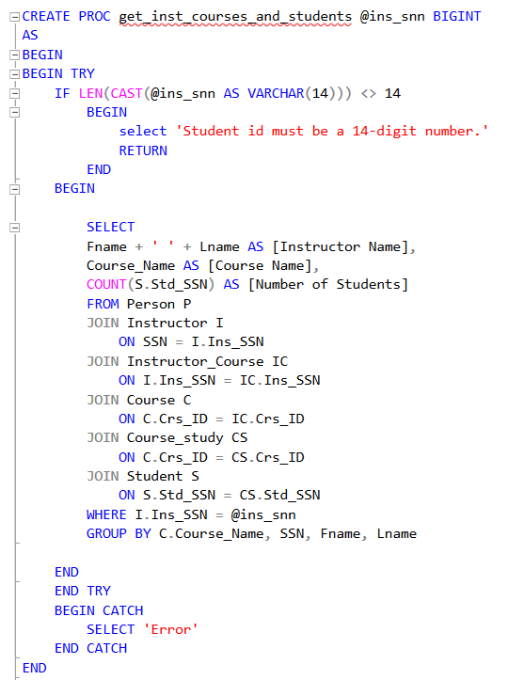
Development Steps: Stored Procedures
Creating Stored Procedure For SSRS Reports
Report No.3:
Report that takes the instructor ID and returns the name of the courses that he teaches and the number of student per course.

Slide 19
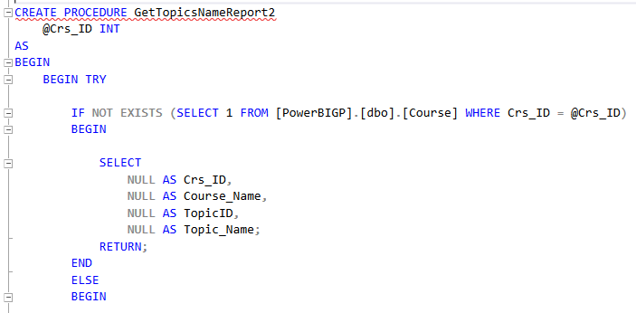
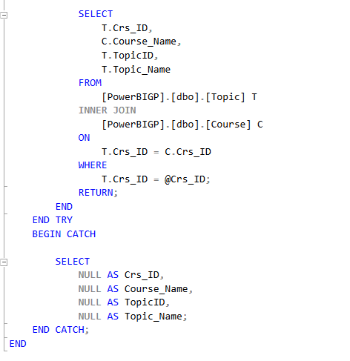
Development Steps: Stored Procedures
Creating Stored Procedure For SSRS Reports
Report No.4:
Report that takes course ID and returns its topics

Slide 20
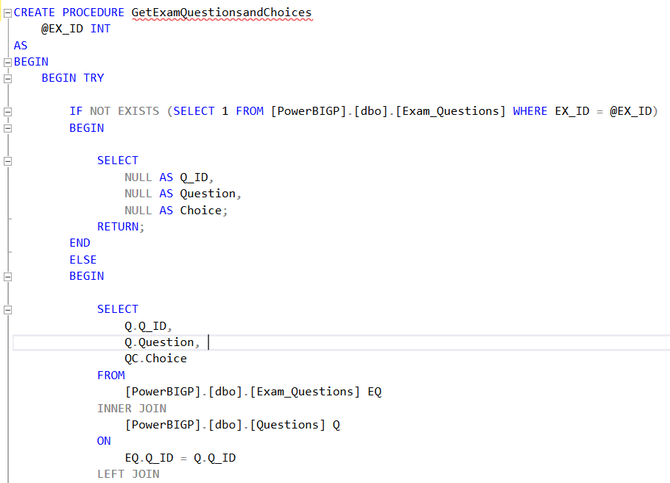
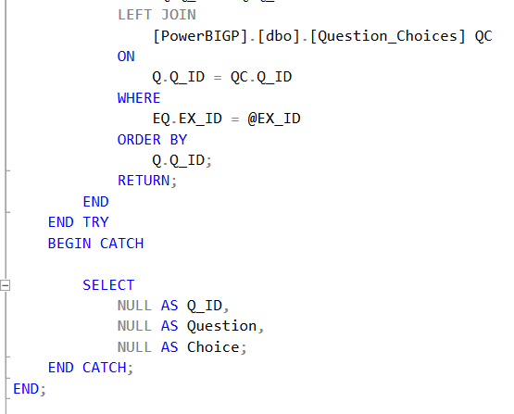
Development Steps: Stored Procedures
Creating Stored Procedure For SSRS Reports
Report No.5:
Report that takes exam number and returns the Questions in it and chocies [freeform report]

Slide 21
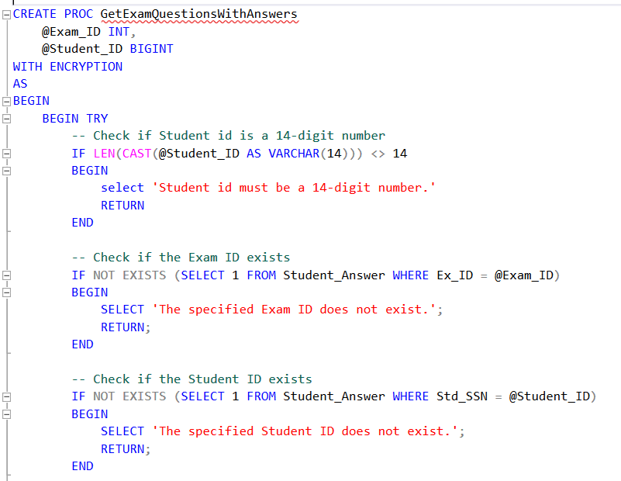
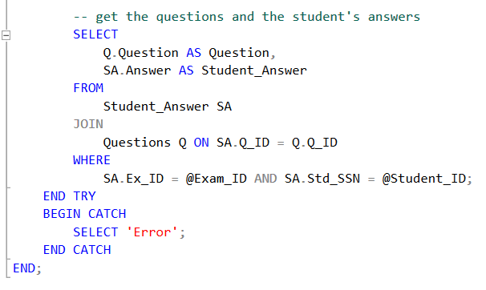
Development Steps: Stored Procedures
Creating Stored Procedure For SSRS Reports
Report No.6:
Report that takes exam number and the student ID then returns the Questions in this exam with the student answers

Slide 22
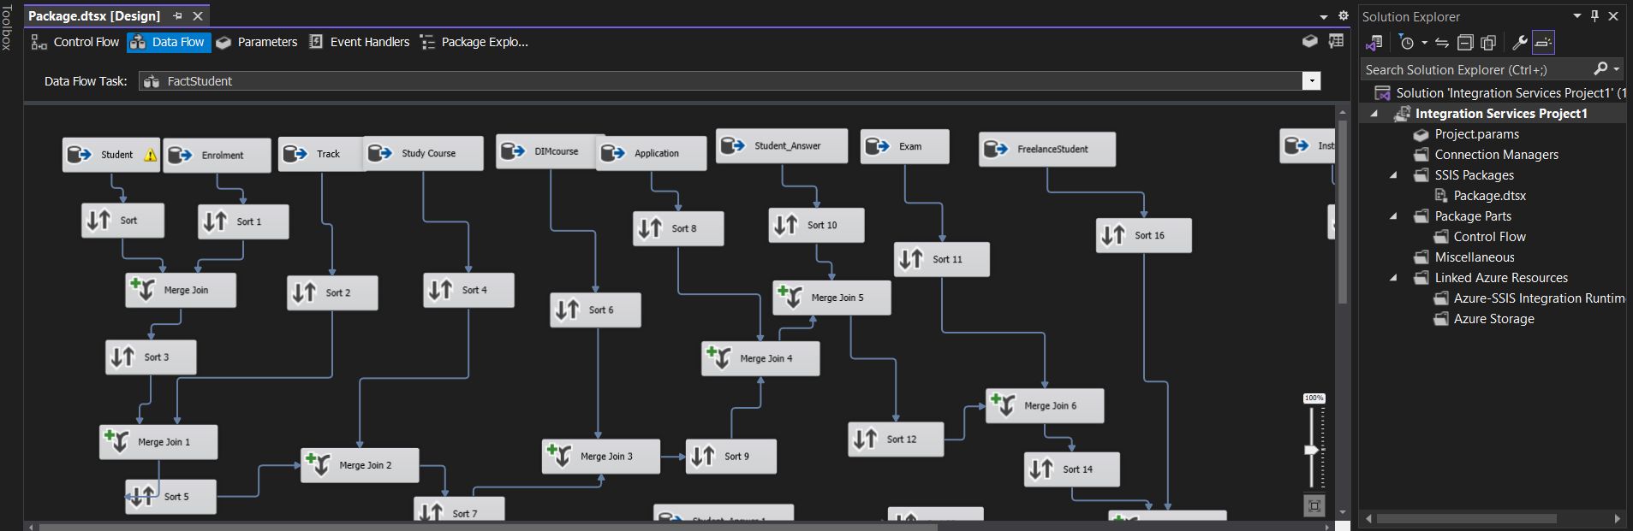
Development Steps: ETL
Creating an ETL Pipeline using SSIS
ETL Process Overview
Extract: Gather data from source systems.
Transform: Cleanse and prepare data.
Load: Insert data into the data warehouse.

Slide 23
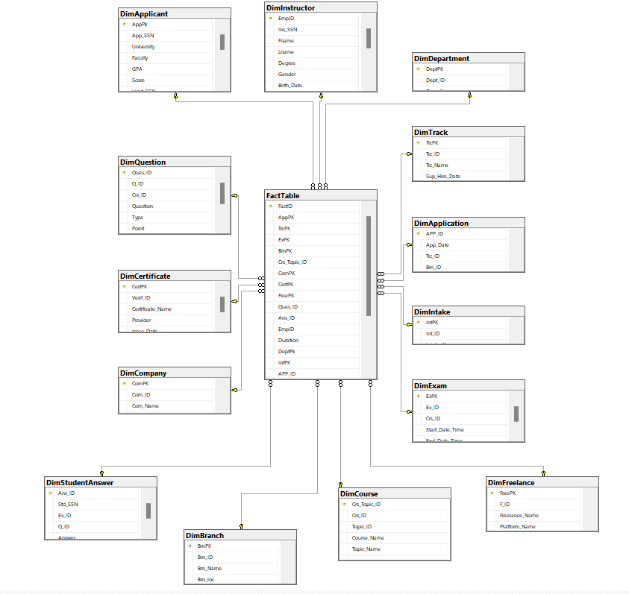
Development Steps: Star Schema Model
Creating an ETL Pipeline using SSIS
Data Warehouse Structure
Star Schema Model

Slide 24

Development Steps: Preparation
Building the Desktop Application
Application Features
User Interface for Students to Take Exams.
Integration with Stored Procedures for Exam Generation and Answer Submission.
Technology Stack
Programming Language (Python)

Slide 25
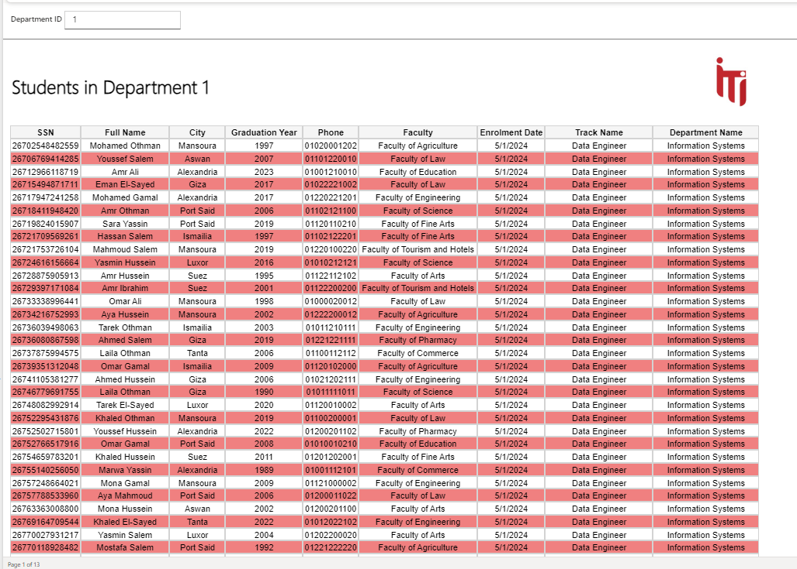
Development Steps: Sharing
Creating Paginated Reports
Tools Used
SQL Server Reporting Services (SSRS)
Power BI Report Builder
Report Examples
Applicant List, Instructor Details, Exam Results.

Slide 26
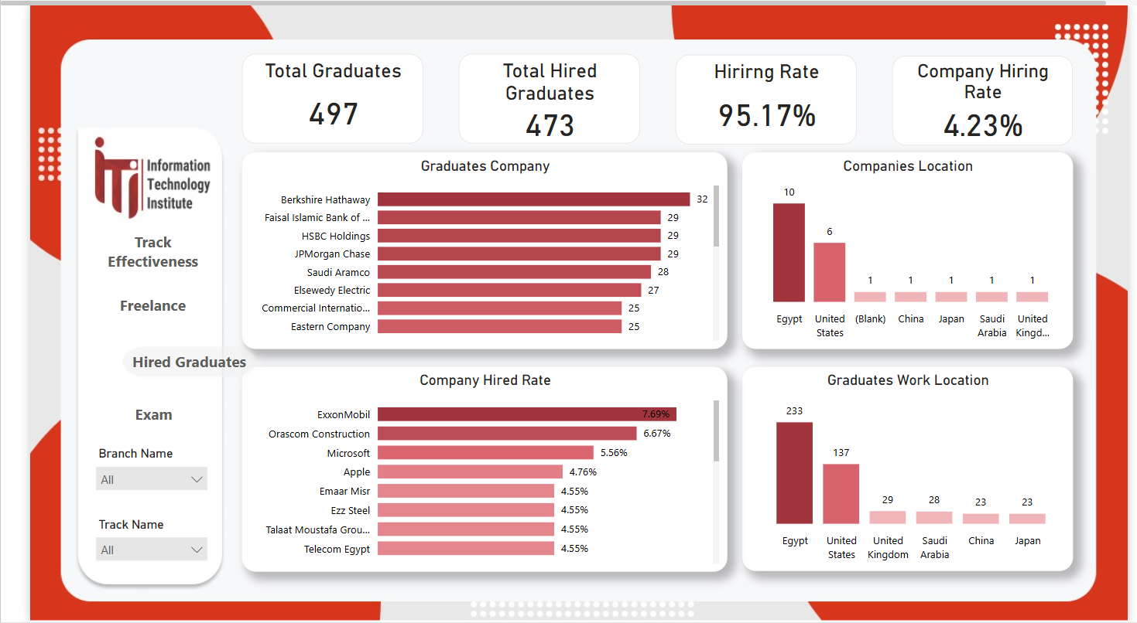
Development Steps: Sharing
Using Power BI for Analytics
Data Cleaning and Transformation
Utilize Power Query for data preparation.
Building Dashboards
Visualizations: Charts, Graphs, Tables.
Examples:
Exam Performance Dashboard
Student Progress Tracker
Sharing Insights
Publish dashboards to Power BI Service.
Enable interactive reports for stakeholders.

Slide 27
Conclusion
Summary of Achievements
Successfully developed a comprehensive online examination system.
Implemented a robust SQL database with optimized stored procedures.
Created insightful reports and dashboards for data-driven decisions.
Future Enhancements
Advanced Analytics with Machine Learning
Enhance ETL Pipeline

Slide 28
Q&A
Thank you for your attention!
Do you have any questions?

